Slide 1

Target store sales prediction
Rahul Sisodia
IDE- Python

Slide 2

Problem Statement
Content:
Here provided with historical sales data for 45 stores located in different region search store contains several departments. The company also runs several promotional markdown events throughout the year. These markdowns precede prominent holidays, the four largest of which are the Super Bowl, Labor Day, Thanksgiving, and Christmas. The weeks including these holidays are weighted five times higher in the evaluation than non-holiday weeks.
Goal: To predict the target sales based on different independent variables

Slide 3
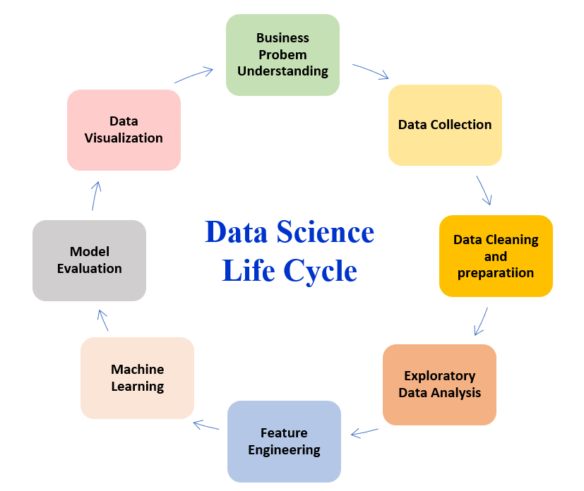
Approach:
Understand the data variables properly
Cleaning the data
Conducting EDA (Exploratory Data Analysis) on the cleaned Data
Uni-variate and Bi-variate Analysis
Hypothesis Testing
Feature Engineering
Identify the most important variables (or data parameters) that affect the final decision Develop and Validate Samples
Model Building
Improving model accuracy:

Slide 4
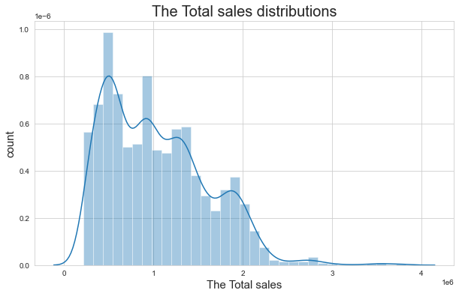
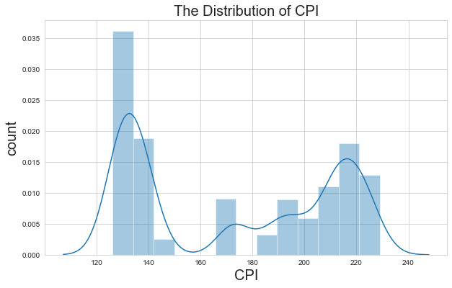
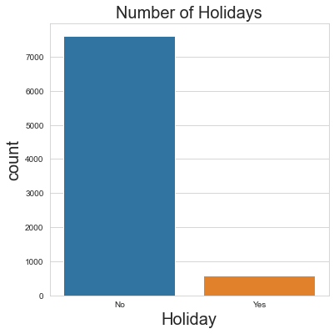
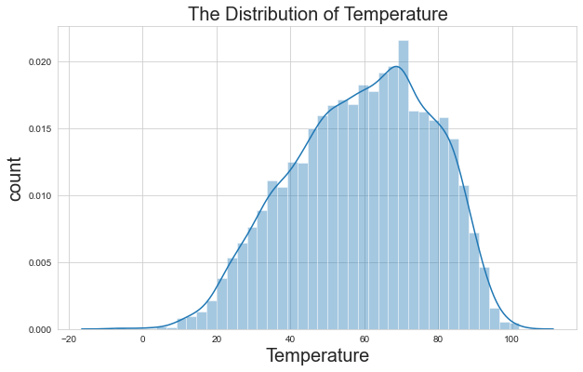
Univariate Analysis
The Distribution of Temperature is almost normally distributed
By looking at Number of Holidays graph we conclude that the sales are mostly happened on Non holidays

Slide 5
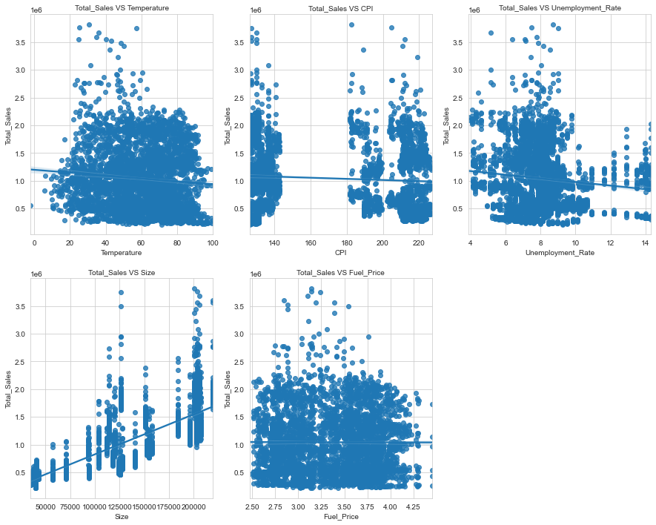
Bivariate Analysis
By looking at graph sales vs size, we can say that there is positive correlation between them
Sales vs Fuel price, we conclude that there is no correlation
Temperature, CPI and Unemployment rate is weak correlation with sales

Slide 6
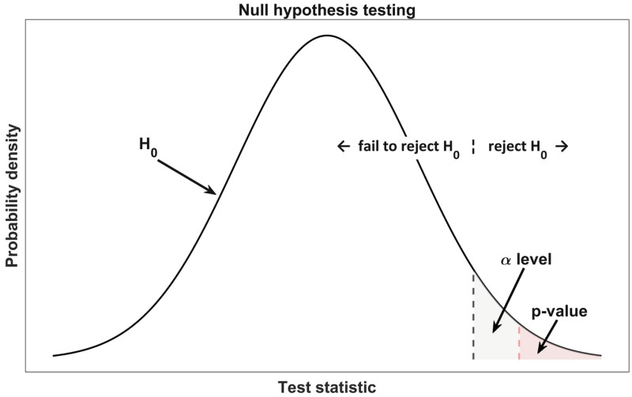
Hypothesis testing
ANOVA
Since our dependent variable is continuous("Total Sales") and independents are both categorical as well as continuous so to
continuous vs continuous -----> correlation
categorical vs continuous----> ANOVA
In ANOVA test, we will find the p value and then we will try to reject or accept the null hypothesis to find whether the independent variable is correlated with the dependent variable or not.
Null: Independent and dependent variables are non-correlated.
Alternate: Independent and dependent variables are correlated.
If p<0.05, we will reject null hypothesis

Slide 7
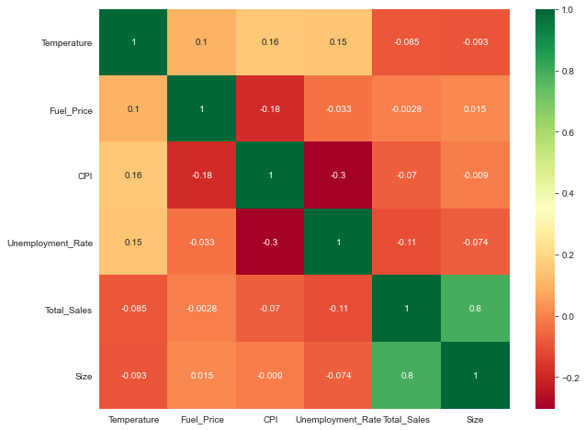
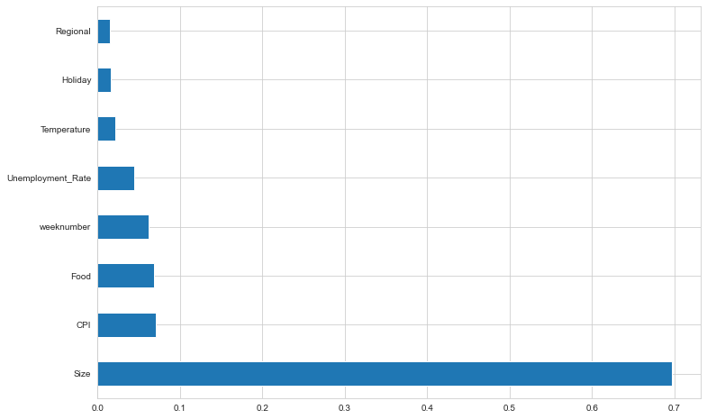
Features selection
By looking at graph we could say that the size of store is important features for building the model followed by CPI, Week Number, unemployment rate and Holidays.

Slide 8
Significant variables
Temperature
Unemployment rate
CPI
Size of store
Holidays
Week number
Features which are import for the building model
Independent features which is statistically significant with dependent features
These features are important for model predictions
Dependent features: Total sales

Slide 9
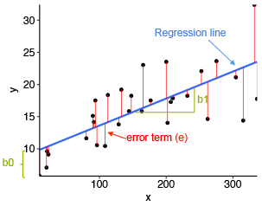
Model Building & Result
Since the Target variables is continuous so, we have used Linear Regression model to predict the sales.
When we have more than one input, we can use Ordinary Least Squares to estimate the values of the coefficients.
The Ordinary Least Squares procedure seeks to minimize the sum of the squared residuals. This means that given a regression line through the data we calculate the distance from each data point to the regression line, square it, and sum all the squared errors together. This is the quantity that ordinary least squares seeks to minimize.
By implementing the Linear Regression model, we have achieved the accuracy around 72%
Mean Absolute Error: 224891.59628264653
Mean Squared Error: 90470646254.37038
Root Mean Squared Error: 300783.3875970719
Mean Absolute percentage Error: 0.26108598877867656

Slide 10
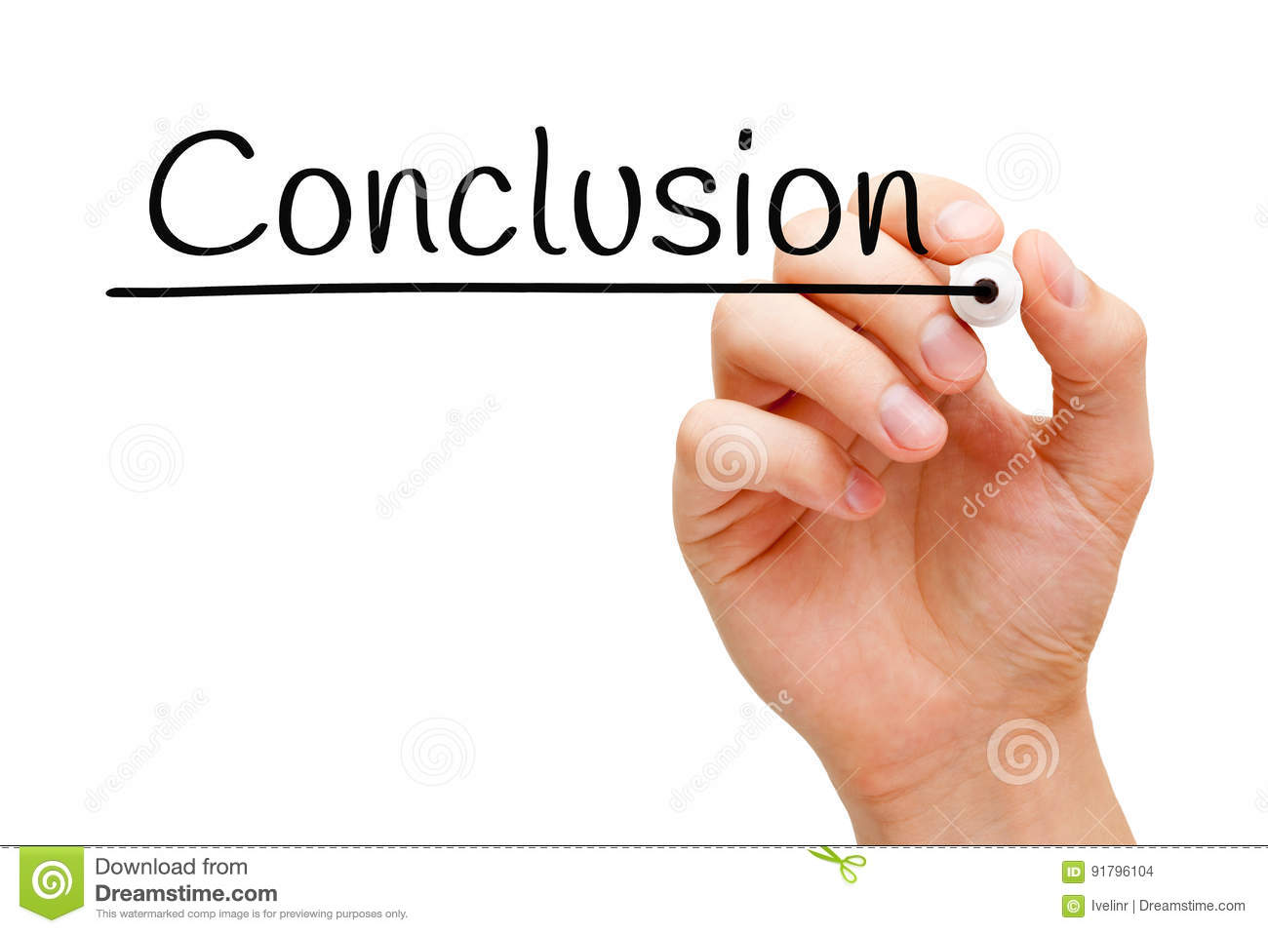
Conclusion
we tried to predict the total sales of sales history data of store which is located on different location. We have built both sklearn and stat model , from sklearn model we got final accuracy of 96.6% and from stat model we achieved 64%. We have done
Data preprocessing
Univariate/Bi-variate analysis
Feature selection
Feature engineering
Model Building
stat model building
prediction of test data

Slide 11


